Slide 1
SENSE
Asset & product
intelligence
01
Decision
Intelligence
Framework
LEARN
EVALUATE
Actual outcomes
& feedback
Treatment
options
05
02
NEXT BEST
ACTION
Resolve | Reconcile | Recover (Circularity)
A unified framework for decision orchestration,
reconciliation, and circular value recovery.
04
03
EXECUTE
OPTIMIZE
Disposition
& recovery
Value, cost &
constraints
CONTINUOUS DECISION & OUTCOME LEARNING
© 2026 Artizent. All rights reserved.

Slide 2
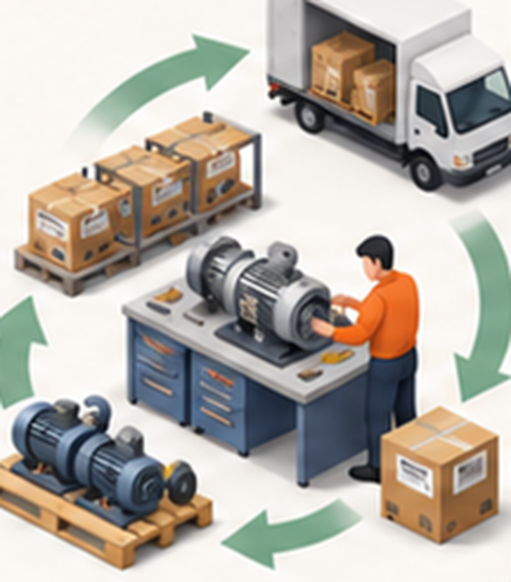
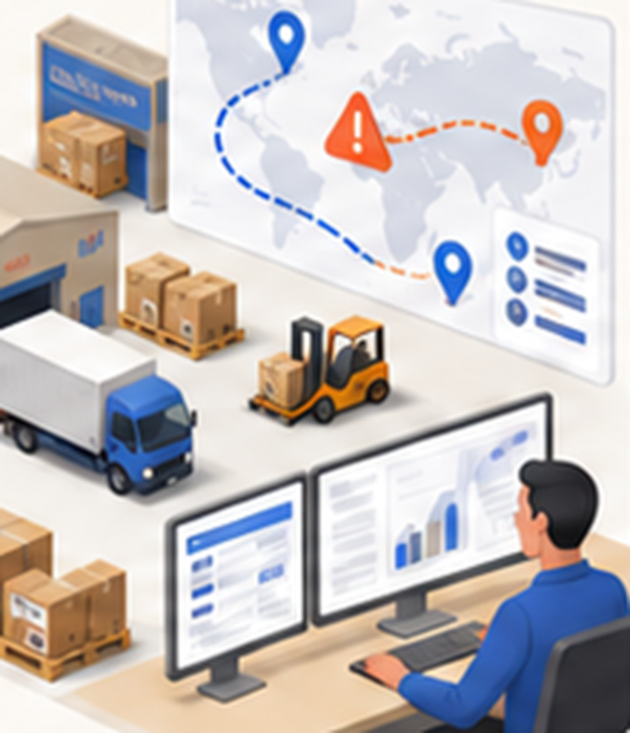
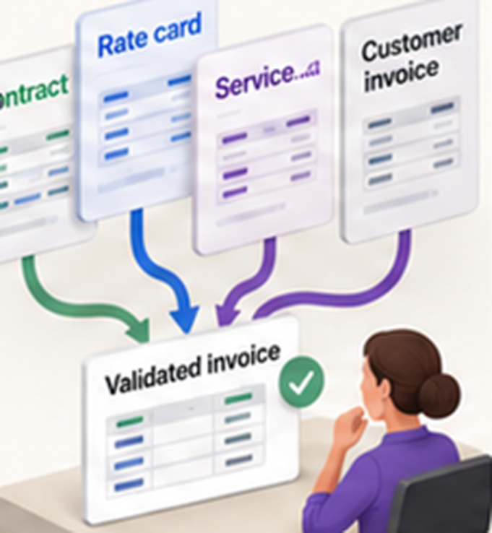
Our Decision Intelligence Framework
Domain-focused modules, powered by one shared layer for intelligence, connectivity and execution
Business modules
Built on one shared framework; more modules can be added
RECOVER (CIRCULARITY)
Get the most value from returned, retired and surplus assets
Predict the best next life: reuse, repair, redeploy, resell or responsible exit
Optimise value, cost, time and risk across the asset pool
Balance commercial, operational and sustainability goals
RESOLVE
Turn disruptions and competing priorities into clear decisions
Anticipate supply, demand and network disruptions
Compare interventions and their consequences
Recommend and coordinate the best action across functions
RECONCILE
(N-WAY INVOICING)
Validate charges before invoicing and prevent disputes
N-way matching across contracts, rate cards, receipts, service and customs records
Generate a proforma with a clear rationale for confirmation
Prevent discrepancies across customer, supplier and partner invoicing
Enterprise signals and context
Products and portfolio | Demand and customers | Supply and suppliers | Operations and assets | Inventory and network | Financial and economic |· Market and external | Sustainability and lifecycle | Risk and disruption | Real-time and historical data | Business context and external signals
Decision intelligence engine
From insight to action
01 Anticipate
Sense change, risk and opportunity early
02 Evaluate
Model consequences and compare alternatives
03 Decide
Recommend the best action in business context
04 Govern
Run execution with control and transparency
Enabling foundations
Data integration and management | AI/ML models and optimization | Business rules and constraints | Domain and industry knowledge | Security, risk and compliance | People, process and governance
Execution, outcomes and learning
ACTION
Recommend, execute and orchestrate through people, processes, applications or autonomous operations
OUTCOME
Measurable business impact: operational, financial, customer, product, sustainability and risk
LEARN
Actual outcomes become new context for the next cycle, so value compounds with every decision
2

Slide 3
One Returned Asset : User Journey and Circularity Interventions ( Happy Path)
Application (Typical Applications Involved)
1 Lease ends
2 Return authorised
3 Pickup and transit
4 Received
5 Inspect and grade
6 Circularity decides
Customer portal and asset tracking (IoT tags, customer app)
Serial, model, site and usage
CRM (Salesforce, Dynamics 365, SAP Sales Cloud)
Customer upgrading to new model
New orders for the same model
Lease and contract management (ERP sales and service, lease platforms)
Lease end date and terms
Fees, payments, replacement order
ERP finance, fixed assets (SAP, Oracle)
Book value and acquisition date
EAM asset register (IBM Maximo, SAP EAM, IFS)
Loan pool 6 units short
TMS and 3PL (Oracle OTM, Blue Yonder, carrier portals)
Pickup date, ETA and freight cost
WMS (Manhattan, SAP EWM, Blue Yonder)
Goods receipt and stock on hand
Repair order management (SAP S/4HANA Service, Oracle Depot Repair, IFS Cloud)
No fault; refurbish estimate $140
Inspection and test results (SAP QM, ETQ, test bench or diagnostic software)
Grade B: gearbox worn, motor OK
ERP procurement and inventory (SAP MM, Oracle)
6 new units requested; motor late
Service parts and supply planning (PTC Servigistics, Syncron, Kinaxis, SAP IBP)
Spare-part forecast and shortages
PLM (Siemens Teamcenter, PTC Windchill, SAP PLM)
Part list and test criteria
Model status, shared parts
Remarketing, recyclers and commodity prices
Buyer, metal and recycling prices
CIRCULARITY decides
Opens a case and starts preparing the decision
Starts the clock on holding cost
Scores 6 outcomes on total value and recommends the best; planner approves
NEXT BEST ACTION for this asset- Sample values
REDEPLOY- Refurbish the gearbox and assign the asset to the internal loan pool | Net value $735 (82% confidence) vs. refurbish to fleet stock $400, harvest parts $170, exit $2; reuse as-is and resell not eligible | Reason: loan pool 6 units short with an open purchase request, so one new $900 purchase is avoided.
Enterprise applications carry out the decision, in sequence
1 Repair order management raises the refurbish order: replace gearbox, service
2 Inspection and test retests the asset and confirms grade A
3 ERP procurement cuts the purchase request from 6 new units to 5
4 WMS puts the asset away to the loan-pool location
5 EAM assigns the asset to the internal loan pool
6 ERP finance reclassifies the asset, closes the lease and posts realised value
7 Sustainability reporting records the outcome and materials kept in use
CIRCULARITY receives the outcome and learns
Receives actual refurbish cost $155 (vs. $140 estimate) and realised value $720
Compares realised $720 with the $735 it predicted for this decision
Tightens the refurbish cost estimate for this model by the $15 overrun
Carries the open motor backorder forward to the next harvest-grade asset of this model

Slide 4
Thank You

